Slide 1
Speech Emotion Recognition
By,
31. Rishabh Parakh
32. Prashant Channe
33. Bhavartha Khawale
34. Furkan Patanwala
35. Manali Shinde

Slide 2
Introduction
As human beings speech is amongst the most natural way to express ourselves.As emotions play a vital role in communication , the detection and analysis of the same is of vital importance in today’s digital world of remote communication. Emotion detection is a challenging task,because emotions are subjective. So we define our SER system as a collection of methodologies that process and classifies speech signals to detect emotions embedded in them.

Slide 3
Solution Overview
There are three classes of features in a speech namely, the lexical features (the vocabulary used), the visual features (the expressions the speaker makes) and the acoustic features (sound properties like pitch, tone, jitter, etc.).
The problem of speech emotion recognition can be solved by analysing one or more of these features. Choosing to follow the lexical features would require a transcript of the speech which would further require an additional step of text extraction from speech if one wants to predict emotions from real-time audio.
Furthermore, the representation of emotions can be done in two ways:
Discrete Classification: Classifying emotions in discrete labels like anger, happiness, boredom, etc.
Dimensional Representation: Representing emotions with dimensions such as Valence (on a negative to positive scale), Activation or Energy (on a low to high scale) and Dominance (on an active to passive scale)

Slide 4
Methodology
Dataset:
In this dataset audio files will be used.
Libraries:
Tensorflow
Keras
ggplot2

Slide 5
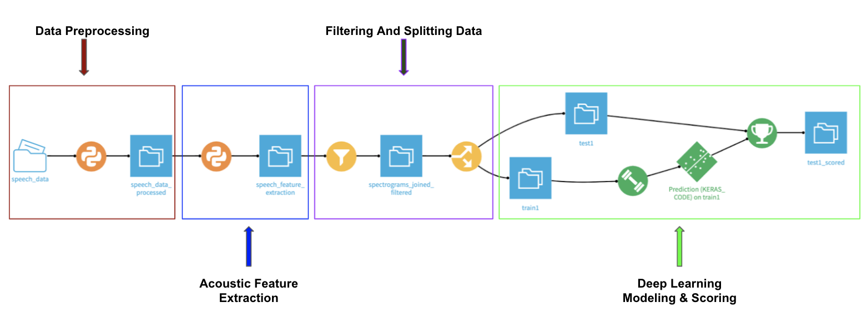
Steps

Slide 6
Data Processing
We need audio data of human voices with labeled emotions
Each audio file in the dataset is embedded with a single emotion
First step is to extract all the emotion labels of corresponding audio files from their file names

Slide 7
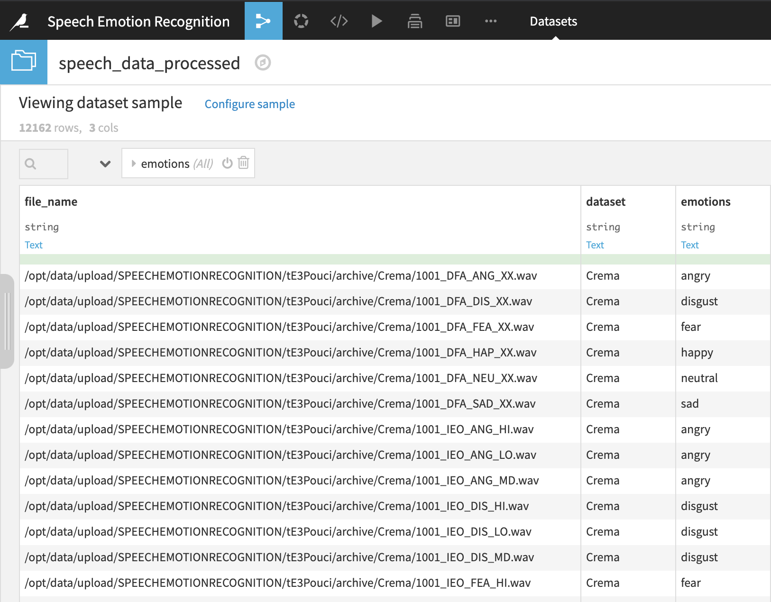

Slide 8
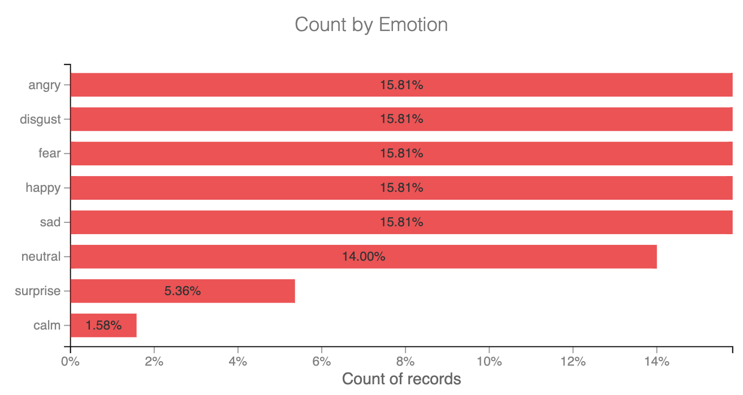

Slide 9
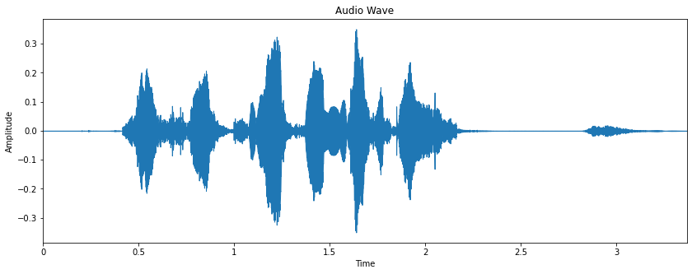
Convert an audio file into a numerical representation
Digital representation of an audio clip can be obtained by using various music and audio analysis packages present in R

Slide 10
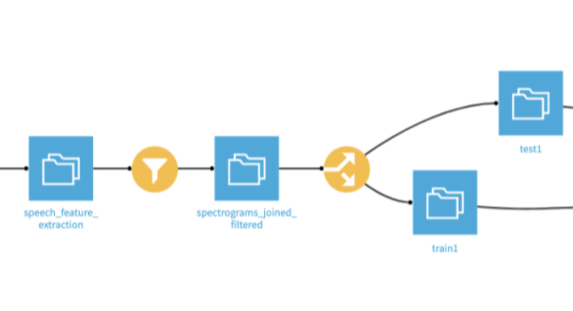
Filtering and Splitting the Dataset
We can split our Dataset by 80% for Training and 20% for Testing

Slide 11
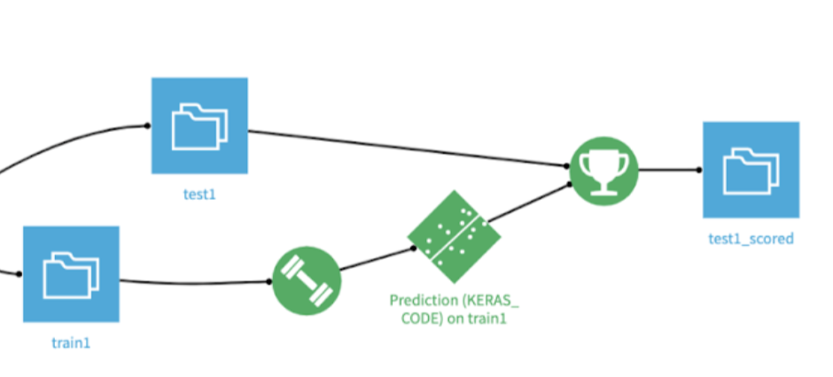
Model building using Deep Learning
The final step is to build the deep learning model which takes features of an audio file as input and predicts the emotion embedded in it.
We will utilize pre-trained models present in Tensorflow & Keras library for building and efficient model quickly

Slide 12
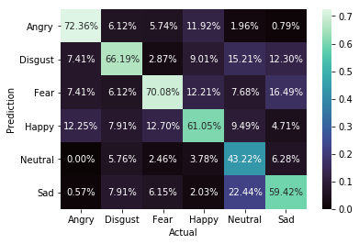
Confusion Matrix - Testing Accuracy

Slide 13
Applications
Gaming
Entertainment
E-learning
Social Media

Slide 14
Conclusion
Through this project, we showed how we can leverage Machine learning to obtain the underlying emotion from speech audio data and some insights on the human expression of emotion through voice.

Slide 15
Future Scope
Convert voice to text
Detect keywords

